Slide 1

University Institute of Technology, RGPV Bhopal MP
Department of Computer Application
Major Project
Fake News Detection using ML
Group Members
Enrollment No. Name
0101CA211048 Saksham Gangrade

Slide 2
Introduction In today‘s society, most of the news consumption by people is through different social media platforms, since it is the most easy and convenient way of sharing news to each other. But with this comes the risk of widespread dissemination of fake news. These fake news not just adversely affect an individual but it also affects the society as a whole.

Slide 3
Objective
The main aim of this project is to develop a web app which recognises whether a news is fake or real with the help of a datasets.
Our objective is in the direction to provide everyone a real stick news so that they may not lead to any misguide information.
The objective of the fake news detection project is to develop an application or system that can accurately identify and classify news articles or information as either "fake" or "not fake" (reliable). The project aims to address the growing issue of misinformation and fake news circulating on various platforms, which can lead to misinformation, manipulation, and public distrust.

Slide 4
Methodology
There are 4 steps involved in the process of fake news detection
First you have to copy the news or type physically.
Then after copying or typing the news you have to click on predict.
Then the news is predicted from the datasets.
After checking from the dataset it will give you the prediction whether a news is fake or real.

Slide 5
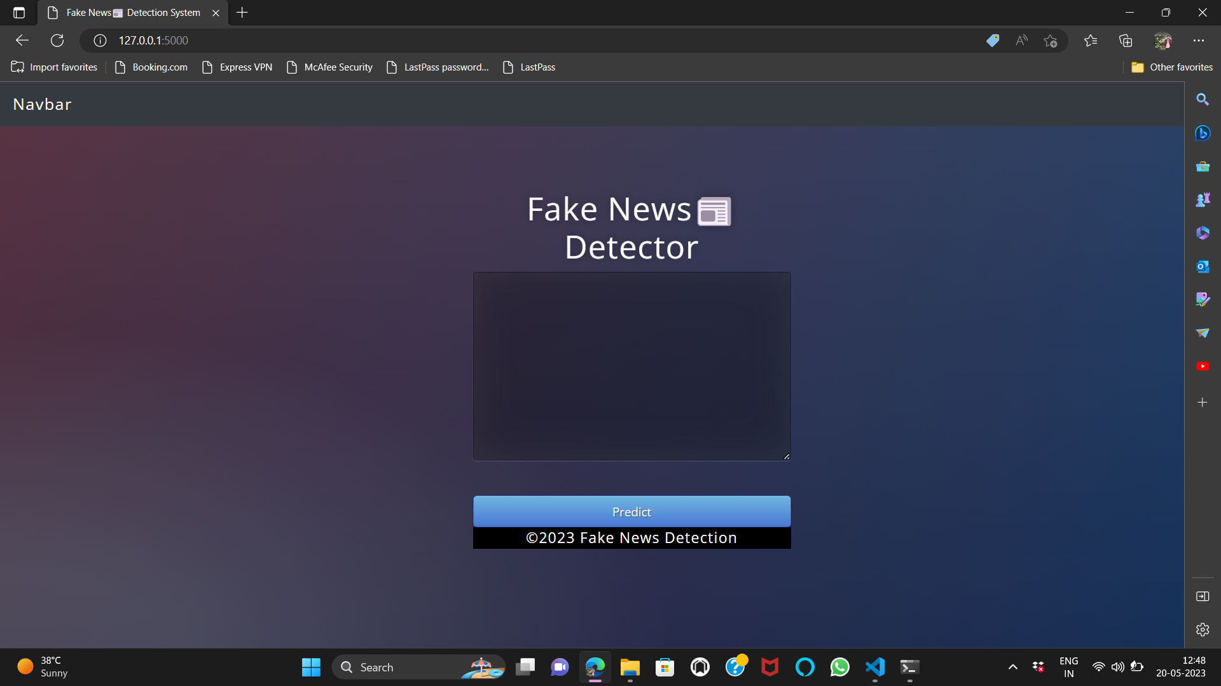
Methodology

Slide 6
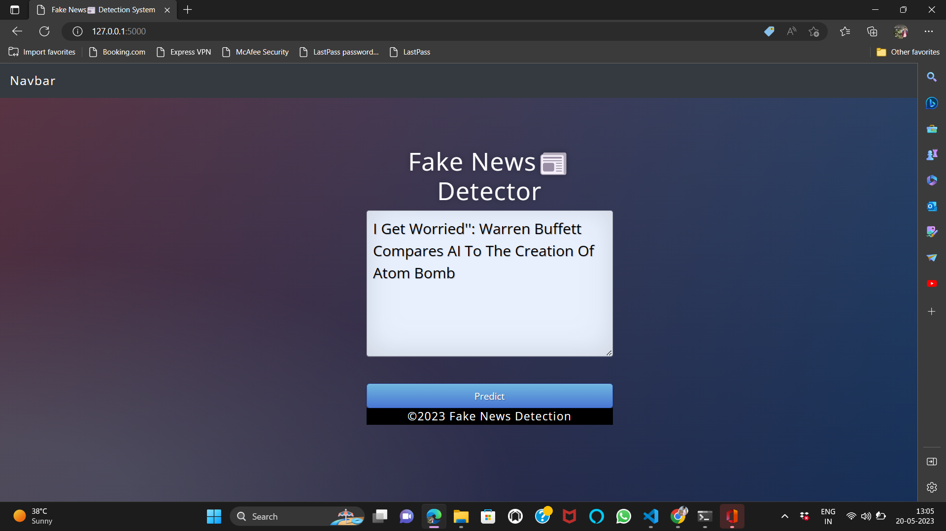
1. First type the news headline

Slide 7
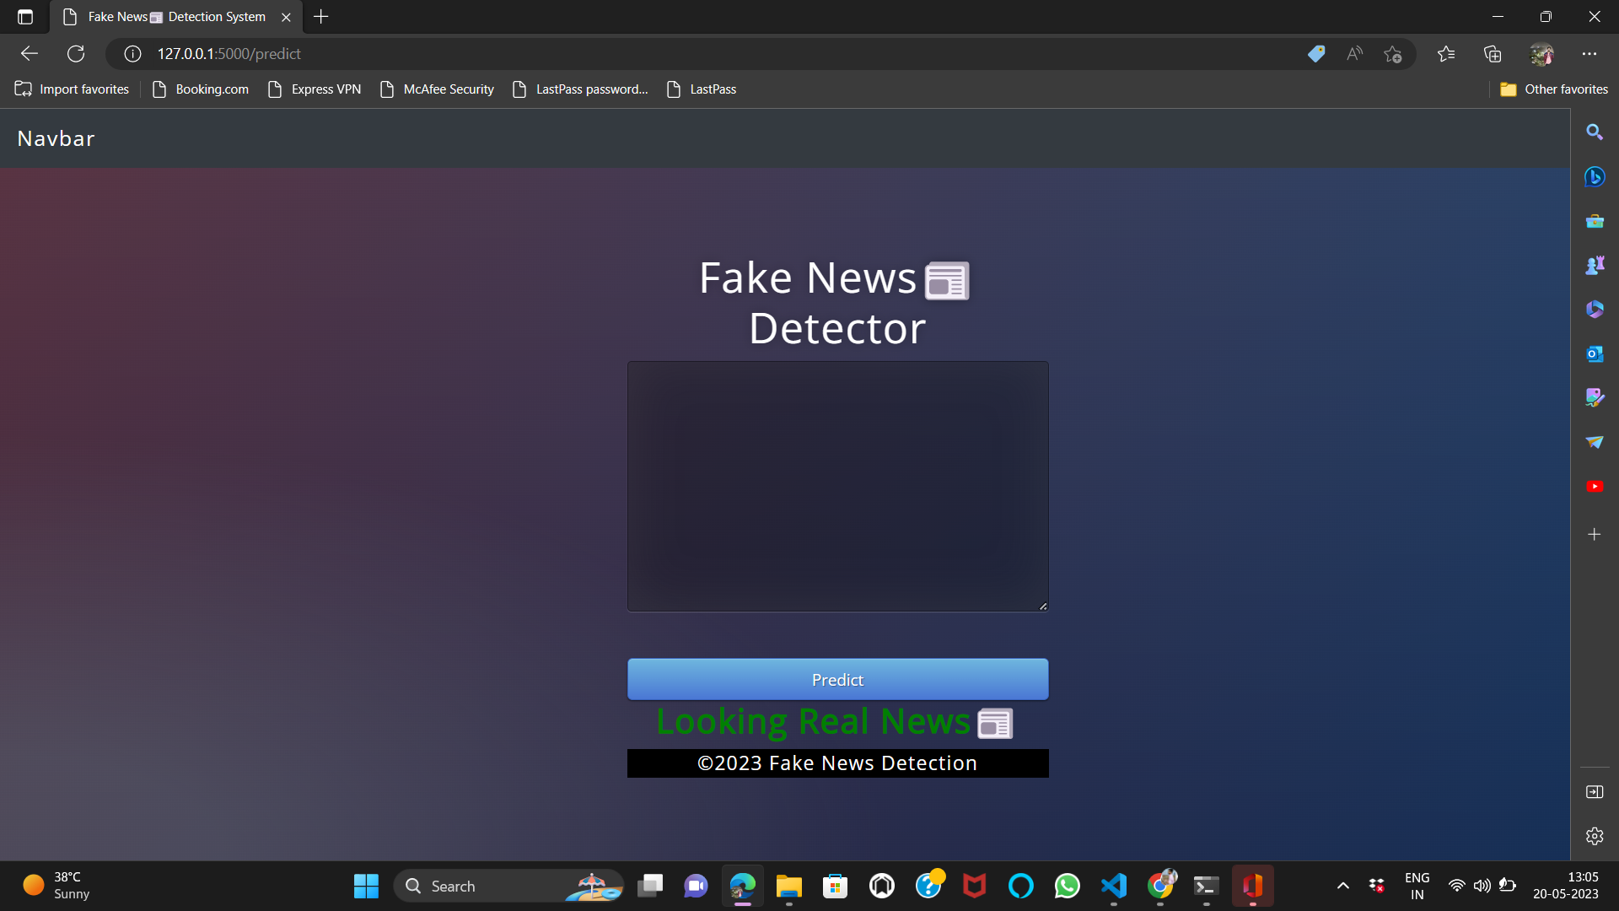
2. Then click on predict and the result shown on the screen

Slide 8
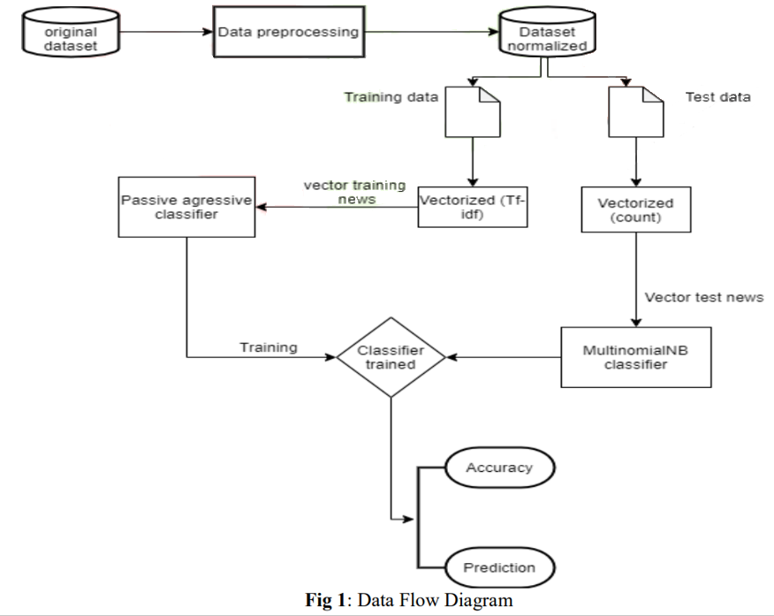
Block Diagram

Slide 9
Softwares used
Language used : Python, HTML, CSS
Libraries used : numpy, pandas, sklearn, flask
IDE: Jupyter, VSCode

Slide 10
Applications
1. Social Media Platforms: Fake news detection can be integrated into social media platforms to identify and flag potentially misleading or false information shared by users. This helps in maintaining the integrity of the platform and reducing the spread of misinformation. 2. News Organizations: News organizations can leverage fake news detection systems to verify the credibility of news articles before publishing or sharing them with their audience. This ensures that only reliable and accurate information is disseminated, maintaining the trust of their readership. 3. Education and Media Literacy: Fake news detection tools can be employed in educational settings to teach students about media literacy, critical thinking, and information evaluation. It empowers individuals to discern reliable sources of information and detect potential misinformation.

Slide 11
References
Kai Shu , Amy Sliva , Suhang Wang , Jiliang Tang , and Huan Liu,2017 september. Fake News Detection on Social Media: A Data Mining Perspective.
Thota, A., Tilak, P., Ahluwalia, S. and Lohia, N., 2018. Fake news detection: A deep learning approach. SMU Data Science Review, 1(3), p.10.
Groza, A., 2020. Detecting fake news for the new coronavirus by reasoning on the Covid-19 ontology. arXiv preprint arXiv:2004.12330.
Gurav, S., Sase, S., Shinde, S., Wabale, P. and Hirve, S., 2019. Survey on Automated System for Fake News Detection using NLP & Machine Learning Approach. International Research Journal of Engineering and Technology (IRJET), 6(01), pp.308-309.
Long, Y., 2017. Fake news detection through multi-perspective speaker profiles. Association for Computational Linguistics.

Slide 12
Thank You

